Slide 1

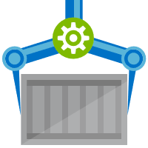
ACR Task
A feature of Azure Container Registry
aka.ms/acr/tasks

Slide 2


Release Management
Resource Pool
Orchestration
HOST-A
Deploy:
web:1 x3
quotes:1 x3
important:1 x4
Image Cache
3
web:1
digest: 91e
web:1
digest: 91e
Foo:
web:1 x3
quotes:1 x3
important:1 x4
web:1
digest: 91e
quotes:1
digest: u82
Container Builder
important:1
digest: 2re
important:1
digest: 2re
Container Registry
HOST-B
Image Cache
quotes:1
digest: u82
quotes:1
digest: u82
7
6
quotes:1
digest: u82
5
web:1
digest: 91e
important:1
digest: 2re
important:1
digest: 2re
important:1
digest: 2re
quotes:1
digest: u82
1
quotes:1
digest: u82
docker build –t web:1
docker build –t quotes:1
docker build –t important:1
docker push web:1
docker push quotes:1
docker push important:1
important:1
digest: 2re
important:1
digest: 2re
Image
web:1
quotes:1
important:1
2
Digests
91e
u82
2re
web:1
digest: 91e
HOST-C
quotes:1
digest: u82
4
important:1
digest: 2re
8
Image Cache
quotes:1
digest: u82
quotes:1
digest: u82
important:1
digest: 2re
important:1
digest: 2re
Notes:
Orchestrator icon from: http://cdn.marketplaceimages.windowsphone.com/v8/images/f58edb21-b20c-4315-b837-6cee21n442cd?imageType=ws_icon_large
https://git-scm.com/book/en/v2/Git-Branching-Basic-Branching-and-Merging

Slide 3






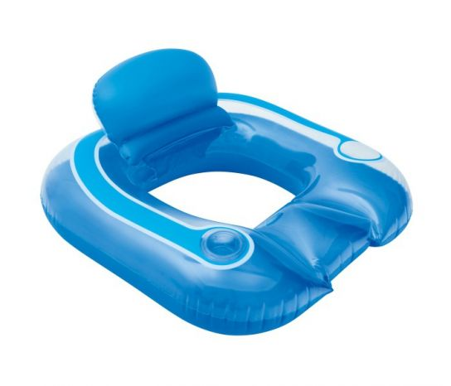
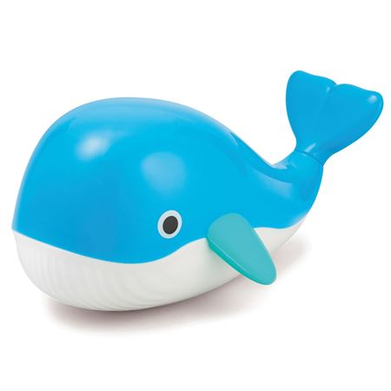




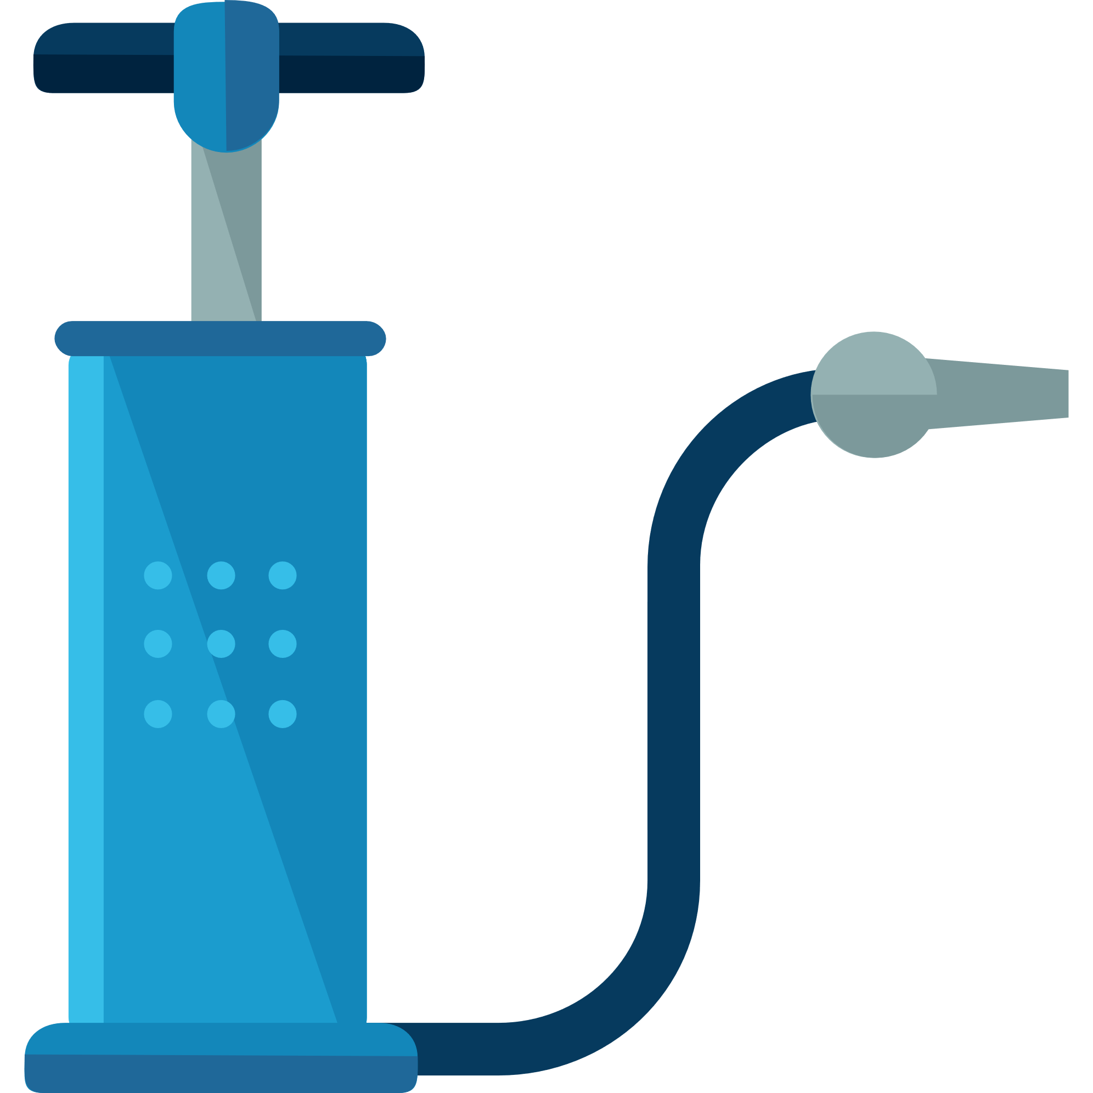


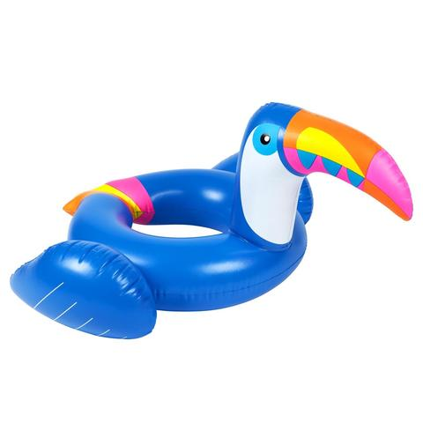
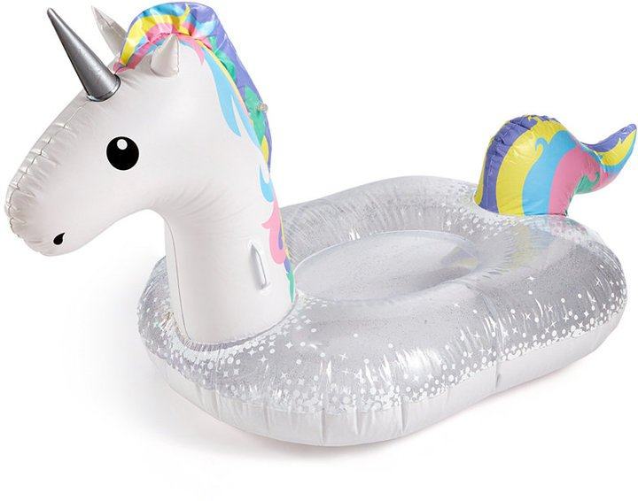
Current Build Infrastructure
Build, Integrate, Test
Hosted Build Agent Pool
Contoso – Build Pool
Northwind – Build Pool

Slide 4
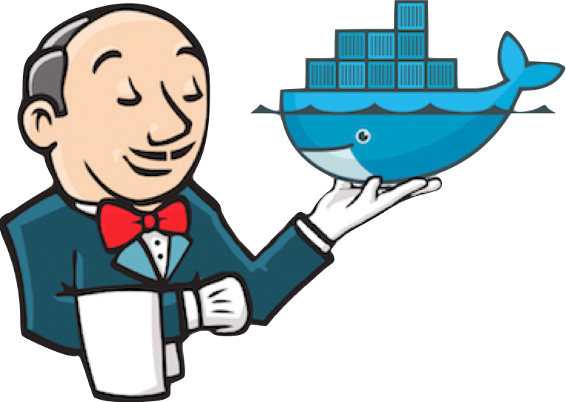
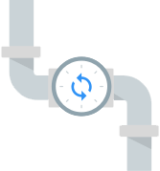


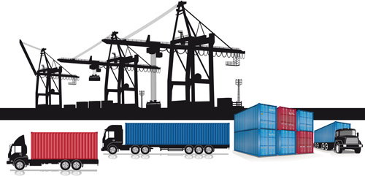
Container Builds - using a Container Mindset
Build, Integrate, Test
Hosted Build Agent Pool

Slide 5
Announcing ACR Tasks A primitive of container lifecycle management
aka.ms/acr/tasks

Slide 6





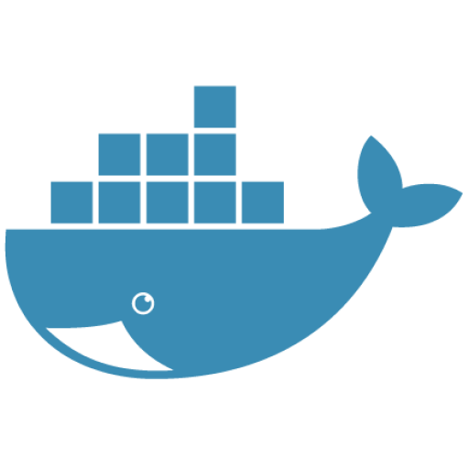




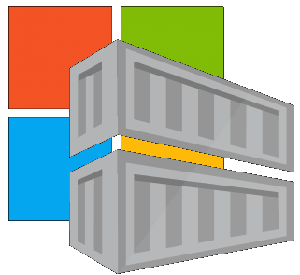


Container Lifecycle Primitives
Host agents monitor, protect and report running containers
3
Container Service
Container Instances
Source Code Control
(SCC)
Build/CI,
Integrate,
Test
CD, Deploy
7
App Services
Upon release, set released flag in ACR (ACR-Auto-purge policies)
Service Fabric
.NET
6
Base Image Index
4
8
1
2
Azure Functions
Docker Hub
ACR Tasks
Azure Container Registry
IoT
Azure Container Registry
Image Security Scanning
Secure by default
Microsoft Container Registry
Inner-Loop
Azure Batch
Run
5
Code
Validate
Debug
* Work in progress

Slide 7




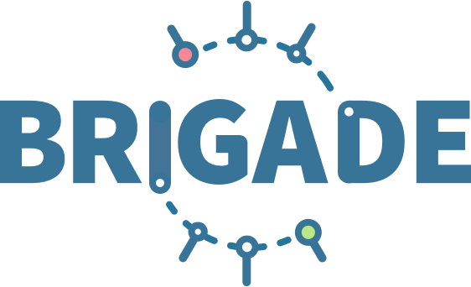
ACR Tasks: Container OS & Framework Patching
.NET
Registries
Docker Hub
MCR
ACR
Build Triggers
SCC Providers
ACR Tasks
Azure Container Registry
aka.ms/acr/tasks

Slide 8


Dockerfile FROM
Functional Tests
Base Images
Commit Id
Task
Id
Context
Dependencies
ACR
d5ab1fa
fx:1
fx:1^{(a)}
fx:1
Web-Build
1
fx:1
web:sha@la
web:1
deploy/test
deploy
web:1
web:1
test:t
Context
d5ab1fa
test:1
Dependencies
web:1
Integration Env
FROM jenga.azurecr.io/baseimages/fx:1
COPY . /output
EXPOSE 80
ENTRYPOINT ["entryPoint"]
If docker build succeeds (including any unit tests),
Save the context & base image dependencies
web:1
az acr task create \
–n Web-Build \
–t web:${{.Run.ID}} \
–c github.com/demo42/web \
–-git-access-token $PAT \
–r jenga
Staging Env

Slide 9
Dockerfile FROM
Functional Tests
Base Images
Commit Id
Task
Id
Context
Dependencies
ACR
fx:1^{(a)}
fx:1
d5ab1fa
Web-Build
1
fx:1
web:sha@la
web:1
deploy/test
deploy
Context
fx:1^{(b)}
fx:1^{(b)}
2
fx:1^{(b)}
web:sha@ya
web:2
deploy/test
deploy
web:2
web:2
d5ab1fa
test:2
test:2
Dependencies
fx:1^{(a)}
web:2
fx ships an OS &/or FX Patch, using the stable 1 tag
The build-task is monitoring changes based on the last build
Integration Env
Base image updates restore the previous context
If Build & Unit Tests Succeed,
Update the base image dependencies
web:2
Staging Env

Slide 10
Dockerfile FROM
Functional Tests
Base Images
Commit Id
Task
Id
Context
Dependencies
ACR
fx:1^{(a)}
d5ab1fa
Web-Build
fx:1
fx:1
Web-Build
1
web:sha@la
web:1
deploy/test
deploy
Context
fx:1^{(b)}
fx:1^{(b)}
2
fx:1^{(b)}
web:sha@ya
web:2
deploy/test
deploy
web:2
web:2
ef26q5c
test:2
d5ab1fa
test:3
fx:2^{(d)}
fx:2^{(d)}
fx:2
ef26q5c
3
fx:2^{(d)}
web:sha@qe
web:3
deploy/test
deploy
web:3
web:3
Dependencies
test:4
Dependencies
fx:1^{(a)}
fx:1^{(b)}
web:3
FROM jenga.azurecr.io/baseimages/fx:2
COPY . /output
EXPOSE 80
ENTRYPOINT ["entryPoint"]
Integration Env
web:2
web:3
If docker build succeeds (including any unit tests),
Save the context & base image dependencies
Staging Env
Container OS & Framework Patching

Slide 11
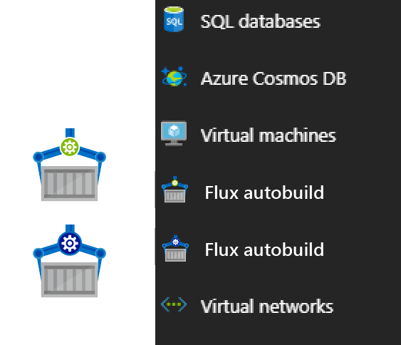


Contoso (Returns)
1 Pull Request
= 1 Build
= 1 Push
= 1 Scan
= 1 Test
= 1 Deploy
$$(1pr=1b+1p+ 1t+1d) ∗life of development$$
Contoso (*)
= 1 Build
= 1 Push
= 1 Scan
= 1 Test
= 1 Deploy
= 1 Build
= 1 Push
= 1 Scan
= 1 Test
= 1 Deploy
= 1 Build
= 1 Push
= 1 Scan
= 1 Test
= 1 Deploy
.NET
Northwind
= 1 Build
= 1 Push
= 1 Scan
= 1 Test
= 1 Deploy
= 1 Build
= 1 Push
= 1 Scan
= 1 Test
= 1 Deploy
= 1 Build
= 1 Push
= 1 Scan
= 1 Test
= 1 Deploy
Smart Hotel 360
= 1 Build
= 1 Push
= 1 Scan
= 1 Test
= 1 Deploy
= 1 Build
= 1 Push
= 1 Scan
= 1 Test
= 1 Deploy
= 1 Build
= 1 Push
= 1 Scan
= 1 Test
= 1 Deploy
Adventure Works
= 1 Build
= 1 Push
= 1 Scan
= 1 Test
= 1 Deploy
= 1 Build
= 1 Push
= 1 Scan
= 1 Test
= 1 Deploy
= 1 Build
= 1 Push
= 1 Scan
= 1 Test
= 1 Deploy
Fabrikam
= 1 Build
= 1 Push
= 1 Scan
= 1 Test
= 1 Deploy
= 1 Build
= 1 Push
= 1 Scan
= 1 Test
= 1 Deploy
= 1 Build
= 1 Push
= 1 Scan
= 1 Test
= 1 Deploy
$$1patch=cust ∗apps ∗ \left(1b+1p+ 1t+1d\right)∗life of the app$$

Slide 12
Image Tagging
Why stable tagging can create instability

Slide 13
HOST-A
Deploy:
web:1 x3
quotes:1 x3
important:1 x4
Image Cache
3
web:1
digest: 91e
web:1
digest: 91e
Foo:
web:1 x3
quotes:1 x3
important:1 x4
web:1
digest: 91e
quotes:1
digest: u82
quotes & important are in inconsistent states
1
important:1
digest: 2re
important:1
digest: 2re
docker build –t web:1
docker build –t quotes:1
docker build –t important:1
docker images
REPOSITORY TAG DIGEST
web 1 91e
quotes 1 u82
important 1 2re
docker push web:1
docker push quotes:1
docker push important:1
HOST-B
Image Cache
quotes:1
digest: u82
quotes:1
digest: u82
9
8
web:1
digest: 91e
5
important:1
digest: 2re
quotes:1
digest: 3rp
important:1
digest: 1n4
important:1
digest: 2re
quotes:1
digest: u82
quotes:1
digest: u82
important:1
digest: 2re
important:1
digest: 2re
Digests
91e
u82
2re
Image
web:1
quotes:1
important:1
2
Digests
91e
u82
2re
3rp
1n4
web:1
digest: 91e
HOST-C
quotes:1
digest: u82
7
4
important:1
digest: 2re
Image Cache
quotes:1
digest: 3rp
quotes:1
digest: 3rp
6
docker build –t quotes:1
docker build –t important:1
docker images
REPOSITORY TAG DIGEST
quotes 1 3rp
important 1 1n4
docker push quotes:1
docker push important:1
important:1
digest: 1n4
important:1
digest: 1n4
quotes:1
digest: 3rp
important:1
digest: 1n4
Notes:
Orchestrator icon from: http://cdn.marketplaceimages.windowsphone.com/v8/images/f58edb21-b20c-4315-b837-6cee21n442cd?imageType=ws_icon_large
https://git-scm.com/book/en/v2/Git-Branching-Basic-Branching-and-Merging

Slide 14
Tagging Techniques
Base Images
FROM …
Stable Tags
Tag
:latest
:1
:2
:3
:1.0
:1.1
:1.2
:2.0
:2.1
:3.0
Digest
91efj6
u82lq
2re7f
3rpn1
1n4ef
5wd1k
Servicing Stable Tags
Tag
:latest
:1
:2
:1.0
:1.1
:1.2
:2.0
Digest
91efj6
u82lq
e8s1f
1n4ef
2re7f
3rpn1
28efq
Deployed Images
docker run …
Unique Tagging
Tag
:12204
:12328
:12401
:33810
:35091
:4201
:50201
Digest
91efj6
u82lq
e8s1f
1n4ef
2re7f
3rpn1
28efq
Notes:
[‎2/‎23/‎2018 3:18 PM] Sajay Antony:
https://git-scm.com/book/en/v2/Git-Branching-Basic-Branching-and-Merging
[‎2/‎23/‎2018 3:37 PM] Sajay Antony:
https://docs.docker.com/storage/storagedriver/
[‎2/‎23/‎2018 4:00 PM] Sajay Antony:
https://www.cockos.com/licecap/
[‎2/‎23/‎2018 5:10 PM] Sajay Antony:
https://docs.docker.com/datacenter/dtr/2.4/guides/user/create-promotion-policies/

Slide 15


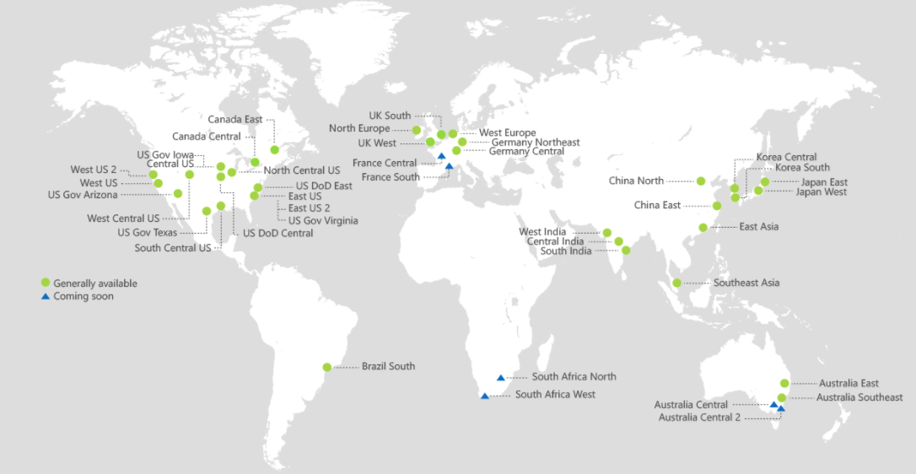
ACR Geo-replication
Mange your global/local deployments as one resource
http://aka.ms/acr/geo-replication

Slide 16
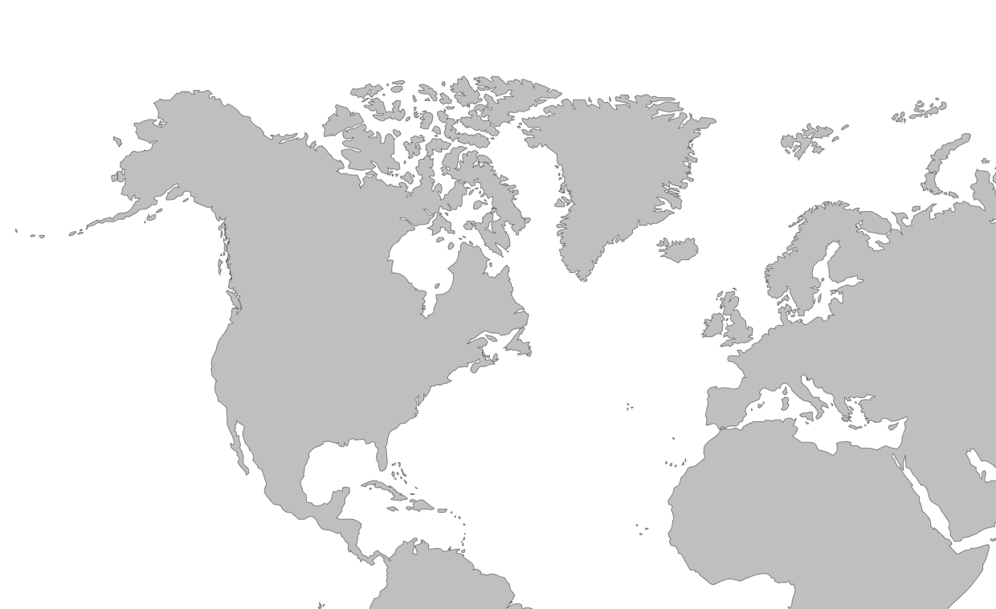

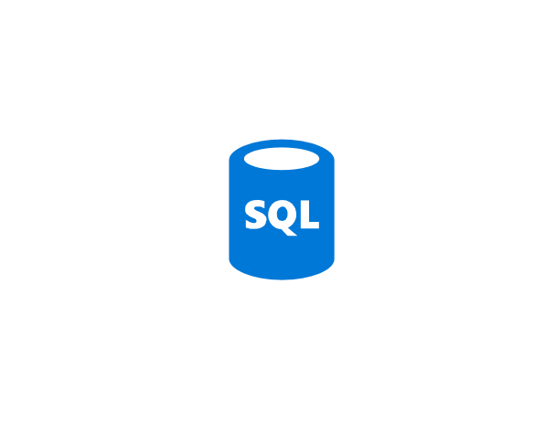

Push Built Images
docker push contosowestus.azurecr.io/web:1234
docker push contosowesteurope.azurecr.io/web:1234
Nodes Pull Images
docker pull contosowestus.azurecr.io/web:1234
docker pull contosowesteurope.azurecr.io/web:1234
Pulls are local, network-close, fast, reliable
Pulls are remote, across the public internet, slower, less reliable
Have network egress fees
Pulls are remote, across the public internet, slower, less reliable
Have network egress fees
West Europe
Canada Central
West US
East US
Developers must push images to n registries, requiring separate management and configuration

Slide 17

Push Built Images
docker push contoso.azurecr.io/web:1234
ACR Syncs Image Blobs
Regional Web Hooks fire for local deployments
Nodes Pull Images
docker pull contoso.azurecr.io/web:1234
Geo-replicate a single registry
All regions have a local replica
Geo-replicate a single registry
All regions have a local replica
West Europe
Canada Central
West US
East US
Each registry is pulling from a local, network close, reliable registry

Slide 18
Azure Container Registry
Providing a single registry across the globe
aka.ms/ACR
aka.ms/ACR/Docs
aka.ms/ACR/Geo-replication
aka.ms/ACR/Roadmap

Slide 19
Authenticating with ACR
Using familiar docker CLIs
Individual Identity, using Azure Active Directory Identity
Server/Headless identity using AAD Service Principals
Provision Service Principals, with scoped access control
Contributor – Push/Pull
Reader – Pull Only
Eg: assign the Kubernetes created principal, desired access to each registry
az login
az acr login --name [registryName]
docker push / pull

Slide 20
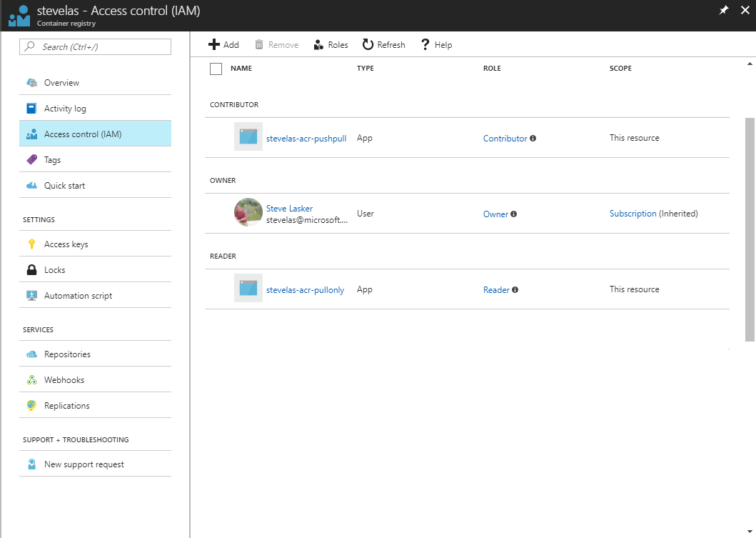
Owner – Push, Pull, ARM Resource Management eg: IAM configuration
Contributor – Push, Pull
Reader – Pull Only

Slide 21
Container Registries Secured by Default
Assuring a registry has images that are scanned and considered secure enough

Slide 22


Secured By Default
Build/Push
Azure Container Registry
Container Hosts
Quarantine Tag
Digest
Tag
91efj6
:1.0
:1.1
u82lq
:1.2
e8s1f
Shifting the container scanning to the left
Partnering with:

Slide 23
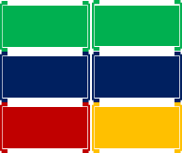
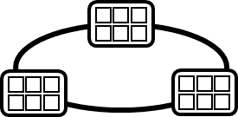
Container Service
Run, Manage
1
Release Management
Container Instances
docker push acrdemos.azurecr.io/th:1.0
Azure Container Registry
Production
environments
App Services
5
6
2
{
"id": "0d799b14-404b-4859-b2f6-50c5ee2a2c3a",
"timestamp": "2018-02-28T00:42:54.4509516Z",
"action": "push-quarantined",
"target": {
"size": 1791,
"digest": "sha256:91ef6
"length": 1791,
"repository": “th",
"tag": "1.0"},
"request": {
"id": "978fc988-1e06-49ee-bf71-4f6e331d1591",
"host": “acrdemos.azurecr.io",
"method": "PUT"}
}
{
"id": "0d799b14-404b-4859-b2f6-50c5ee2a2c3a",
"timestamp": "2018-02-28T00:42:56.4509516Z",
"action": "push",
"target": {
"size": 1791,
"digest": "sha256:91ef6
"length": 1791,
"repository": “th",
"tag": "1.0"},
"request": {
"id": "978fc988-1e06-49ee-bf71-4f6e331d1591",
"host": “acrdemos.azurecr.io",
"method": "PUT"}
}
3
docker pull th@sha256:91ef6
4
az acr policy set –n acrdemos --quarantine-remove –-image th@sha256:91ef6
or
az acr policy set –n acrdemos --quarantine-block –-image th@sha256:91ef6
Notes:
{
"id": "0d799b14-404b-4859-b2f6-50c5ee2a2c3a",
"timestamp": "2018-02-28T00:42:54.4509516Z",
"action": "push-quarantined",
"target": {
"mediaType": "application/vnd.docker.distribution.manifest.v2+json",
"size": 1791,
"digest": "sha256:91ef6
"length": 1791,
"repository": “th",
"tag": "1.0"
},
"request": {
"id": "978fc988-1e06-49ee-bf71-4f6e331d1591",
"host": "jengademos.azurecr-test.io",
"method": "PUT",
"useragent": "docker/18.03.0-ce-rc1 go/go1.9.4 git-commit/c160c73 kernel/4.9.75-linuxkit-aufs os/linux arch/amd64 UpstreamClient(Docker-Client/18.03.0-ce-rc1 \\(windows\\))"
}
}

Slide 24
Quarantine – Image Access
docker push acrdemos.azurecr.io/th:1.0
docker push acrdemos.azurecr.io/th:1.0
docker pull th@sha256:91ef6
docker pull th@sha256:e8s1f
az acr policy set –n acrdemos --quarantine-remove –-image th@sha256:91ef6
az acr policy set –n acrdemos --quarantine-remove –-image th@sha256:e8s1f
docker push acrdemos.azurecr.io/th:1.1
docker push acrdemos.azurecr.io/th:1.0
docker pull th@sha256:u82lq
docker pull th@sha256:3r2s7
az acr policy set –n acrdemos --quarantine-remove –-image th@sha256:u82lq
az acr policy set –n acrdemos --quarantine-fail –-image th@sha256:3r2s7
Tag
Digest
91efj6
u82lq
e8s1f
3r2s7
Quarantine Tag
:1.0
:1.1
:1.0
:1.0

